Slide 1
Kultra Mega Stores - BI Insights Summary
2009–2012 Inventory & Customer Data Analysis
Notes:
Welcome to the KMS BI Insights Summary. This presentation covers key findings from 2009 to 2012 sales and shipping data to guide strategic decisions.

Slide 2
Top Performing Areas
• Technology is the highest-selling product category
• West, Ontario, and Prarie regions contributed the most sales
• Suggests strong demand and operational strength in these areas
Notes:
Technology led all product categories in sales. The West, Ontario, and Prarie regions showed the strongest market presence, suggesting where to reinforce success.

Slide 3
Areas of Concern
• Yukon, Northwest Territories, and Nunavut had the lowest sales
• Bottom 10 customers contributed < ₦500 over 4 years
• Possible causes: logistics issues, low engagement, limited campaigns
Notes:
Sales were lowest in Yukon, Northwest Territories, and Nunavut. These regions may suffer from limited logistics or marketing, which we can address directly.

Slide 4
Shipping Costs & Practices
• Delivery Truck incurred the most shipping cost
• Express Air underused even for critical orders
• Shipping methods not aligned with urgency
Notes:
Shipping cost analysis shows Delivery Truck is the most used and costly, yet Express Air—though fast—is underused, even for high-priority orders.

Slide 5
Customer Segmentation Insights
• Emily Phan: Top spender & most profitable consumer
• Deborah Brumfield: High-value tech buyer
• Roy Skaria (Corporate): Most orders placed
• Dennis Kane (Small Biz): Highest segment sales
Notes:
Our top customers by revenue span all segments. Emily Phan is our most profitable consumer. Roy Skaria leads in corporate orders. This indicates strong loyalty across segments.

Slide 6
Strategic Recommendations
• Align shipping mode with order priority levels
• Launch loyalty campaigns for low-spend customers
• Expand Technology promotions to weak regions
• Explore marketing in low-sales regions (Yukon, Nunavut)
Notes:
We recommend aligning shipping with priority levels, engaging low-spending customers with loyalty campaigns, and boosting tech sales in underserved areas.

Slide 7
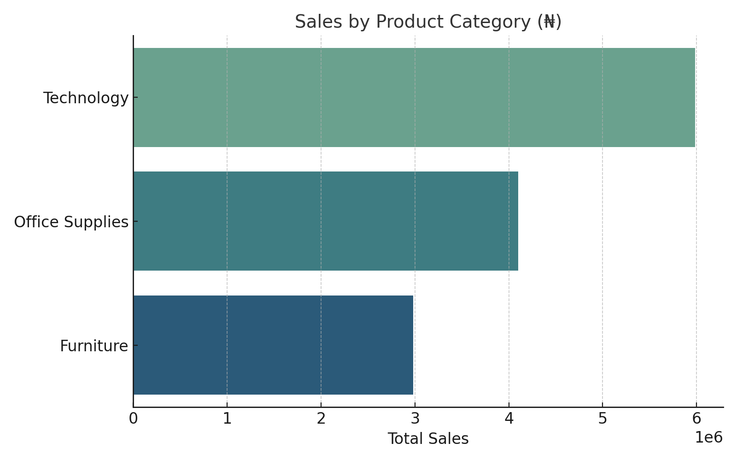
Sales by Product Category
Notes:
This chart confirms Technology as the top-selling category, indicating a strong customer demand for innovation and devices.

Slide 8
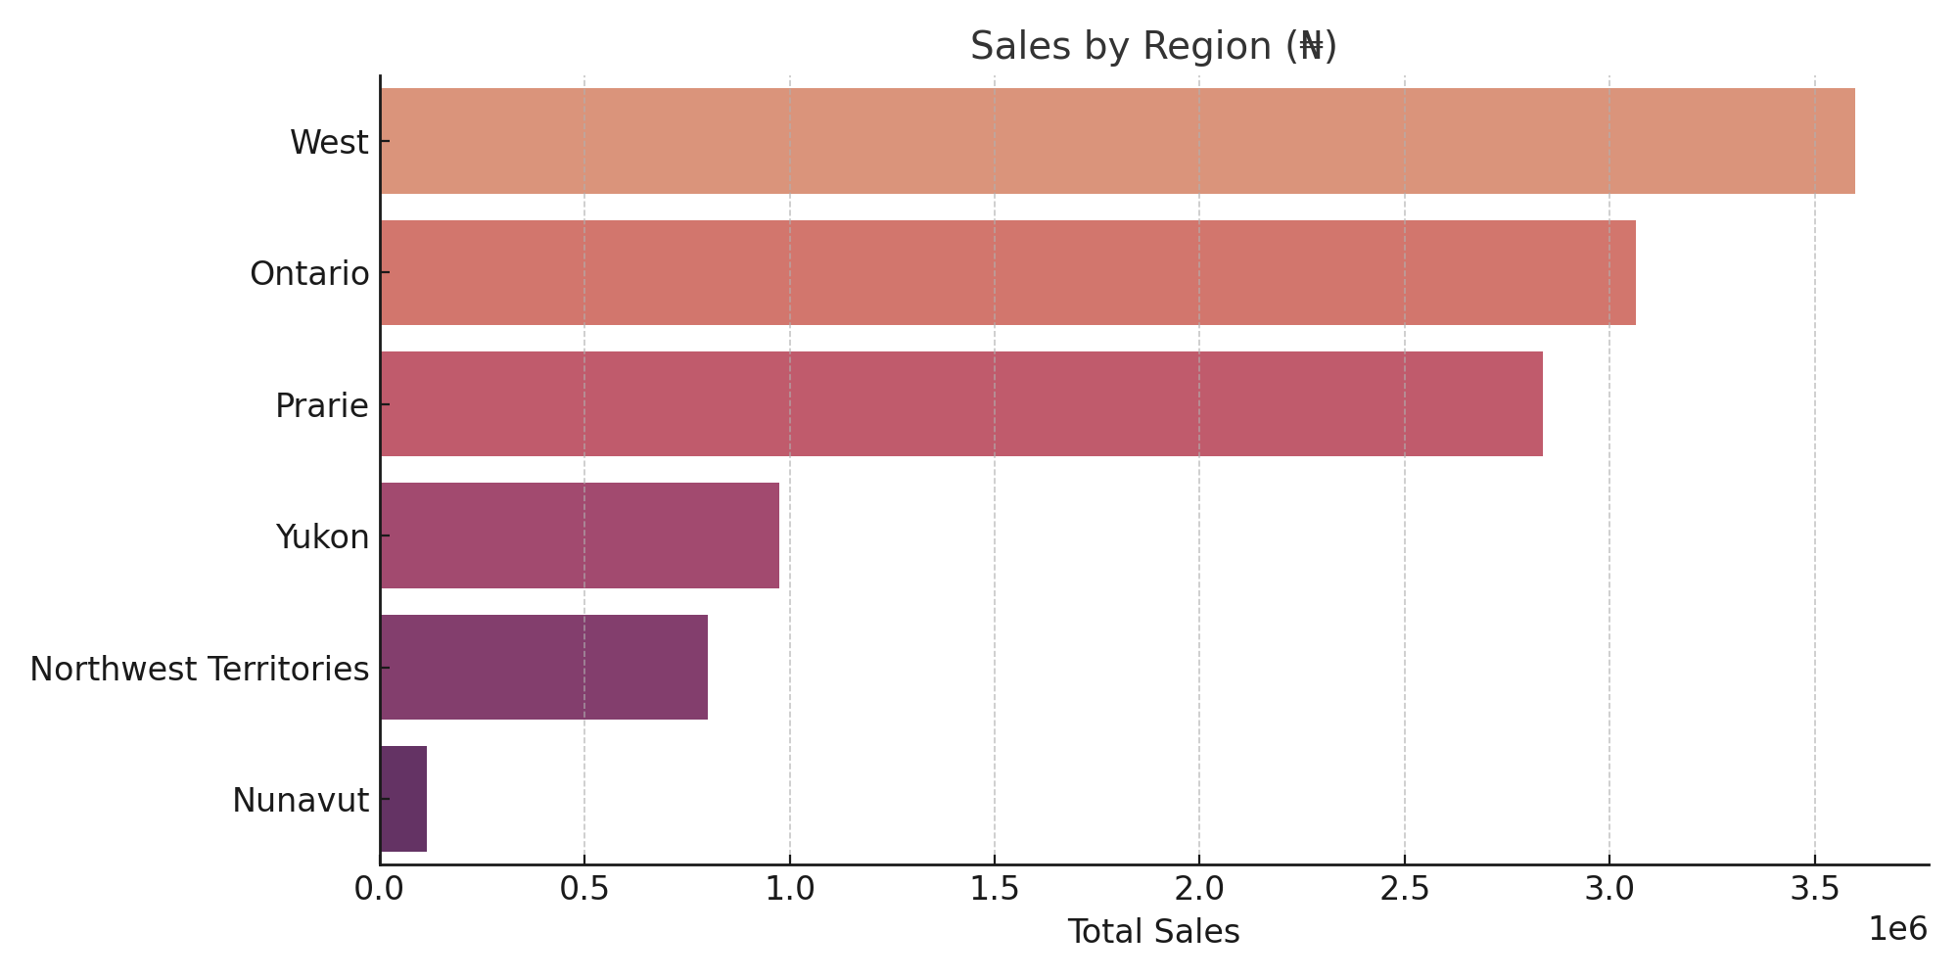
Sales by Region
Notes:
Regional sales are clearly dominated by the West and Ontario. Strategic efforts should focus on improving visibility in underperforming areas.

Slide 9
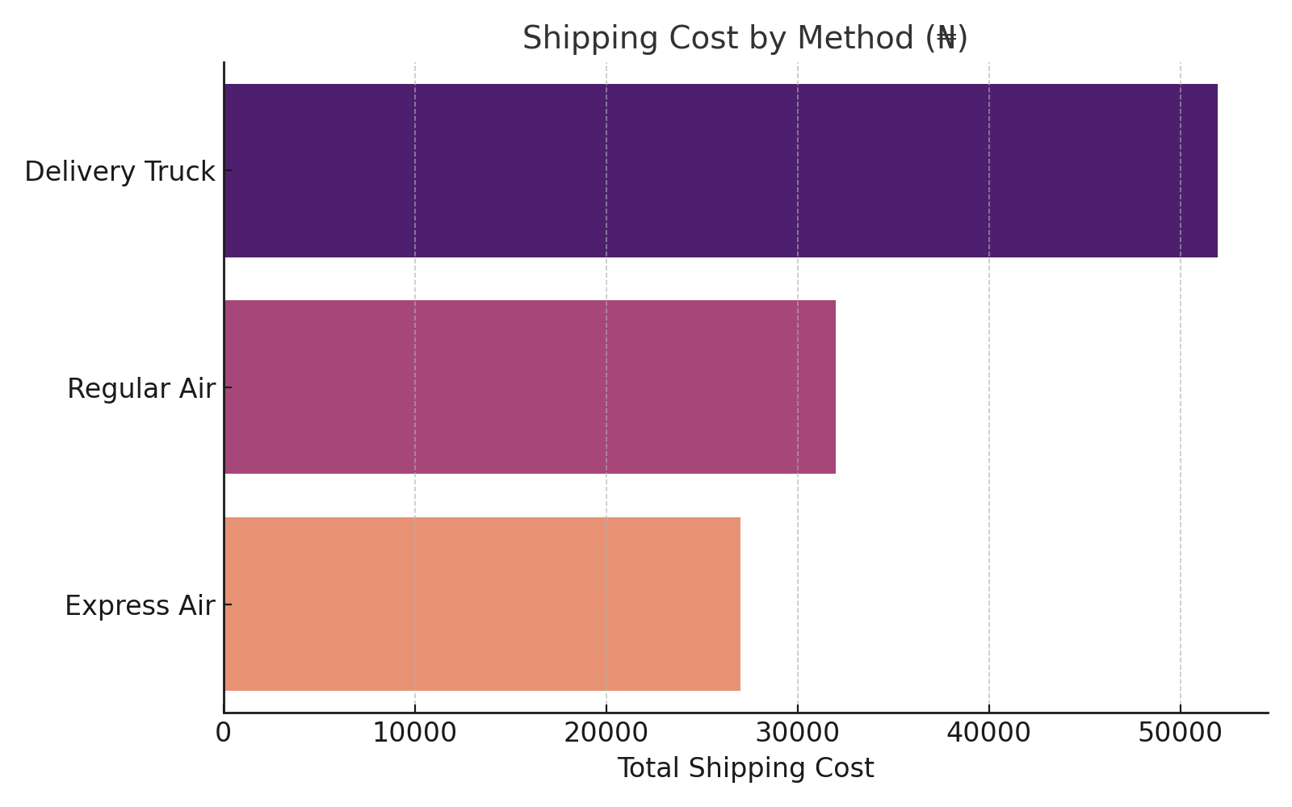
Shipping Cost by Method
Notes:
Shipping cost data supports the need to optimize logistics. We must reevaluate when to use Express Air versus Delivery Truck for profitability.

Slide 10
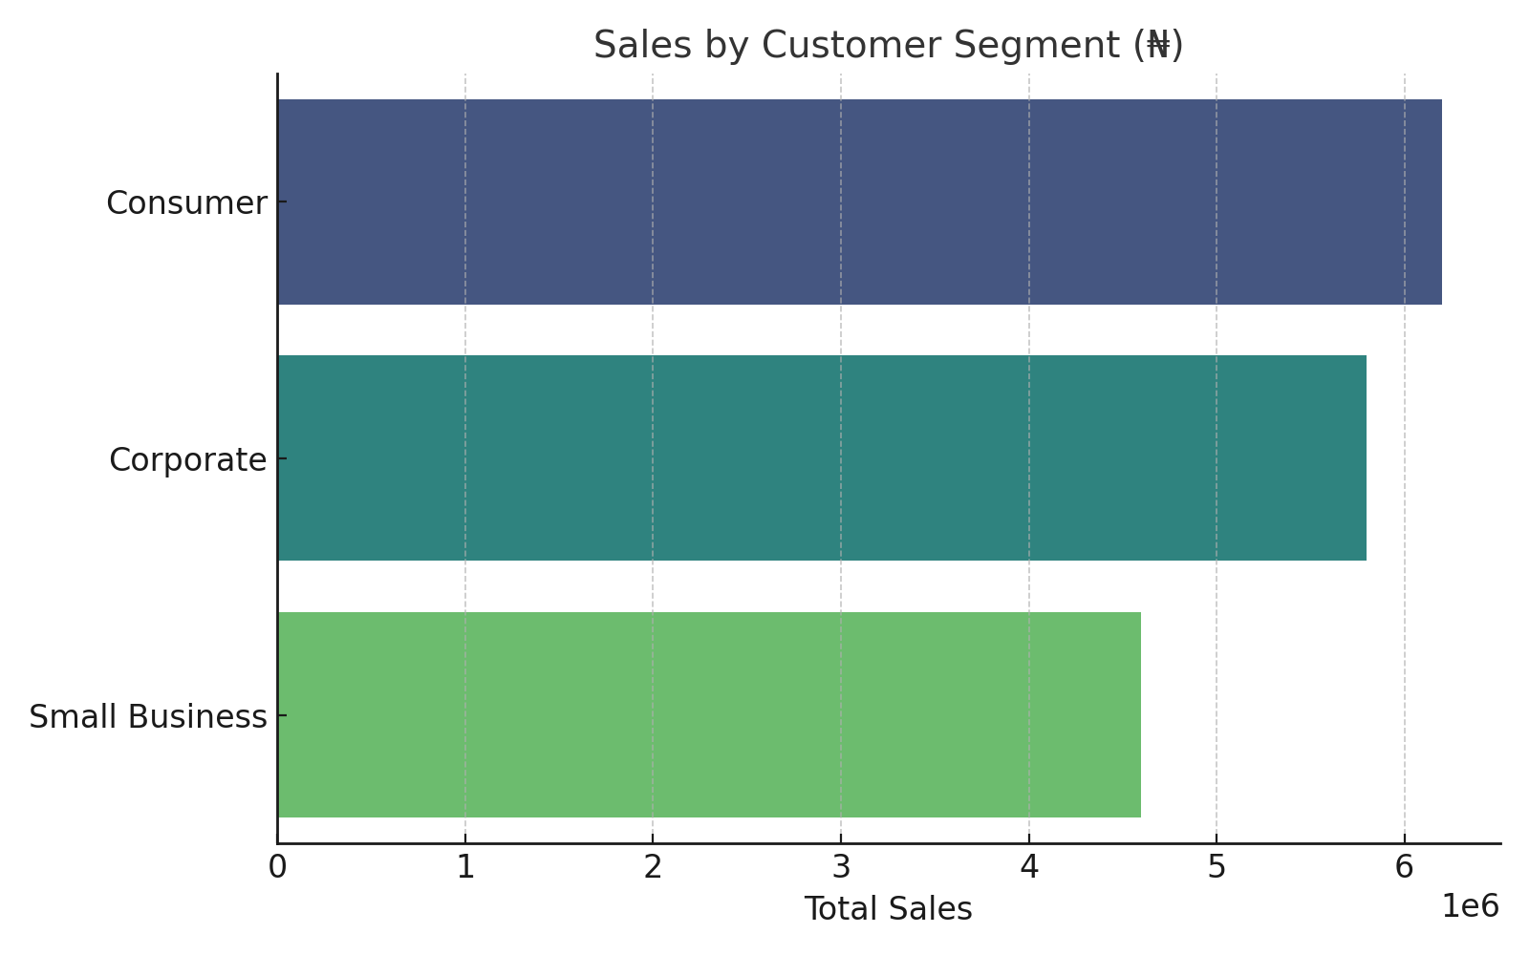
Sales by Customer Segment
Notes:
Customer segment sales show consistent contribution from Consumer, Corporate, and Small Business clients—each of which merits tailored campaigns.

